Slide 1
CHAPTER
16
Monopolistic Competition
Notes:
Examples of monopolistic competition are everywhere: the clothes students wear, the fancy frozen coffee drinks they slurp up on their way to class, the magazines they read, the nightclubs where they dance.
As a result, students find the theory of monopolistic competition more relevant than the theory of perfect competition, which best describes products like wheat and soybeans, products that few students ever consider buying.
The last part of the chapter, on advertising and brand names, is especially interesting & useful for business students.
If students are reasonably comfortable with the material on perfect competition and monopoly, then this chapter should not be difficult. It is also shorter than average.

Slide 2
Introduction
Two extremes
Perfect competition: many firms, identical products
Monopoly: one firm
Imperfect competition – in between the extremes:
Oligopoly: only a few sellers offer similar or identical products.
Monopolistic competition: many firms sell similar but not identical products.
Notes:
In the preceding two chapters, we studied the two extremes of the competition spectrum. This chapter focuses on monopolistic competition, one of the market structures in between the two extremes.
Examples of each market type:
Perfect competition: wheat, milk
Monopoly: tap water, cable TV
Oligopoly: tennis balls, cigarettes (we study oligopoly in the next chapter)
Monopolistic competition: novels, movies

Slide 3
Comparisons
Perfect Monopolistic
Competition Competition Monopoly
Number of sellers Many Many One
Free entry/exit Yes Yes No
Long-run
economic profits Zero Zero Positive
The products No close
firms sell Identical Differentiated substitutes
Firm has market None;
power? price-taker Yes Yes
D curve Downward- Downward-
facing firm Horizontal sloping sloping (market D)
Notes:
Monopolistic competition
- Long-run profits for are zero because of free entry/exit.
- The market power: it sells a product that is at least somewhat different from products sold by other firms.
- The D curve is downward-sloping because the firm has a bit of market power and sells a unique variety.
A monopoly is the sole seller of a product with no close substitutes. In contrast, the monopolistic competitor sells a product with many close substitutes. As a result, demand for the monopolist’s product is less elastic than demand for the monopolistic competitor’s product.

Slide 4
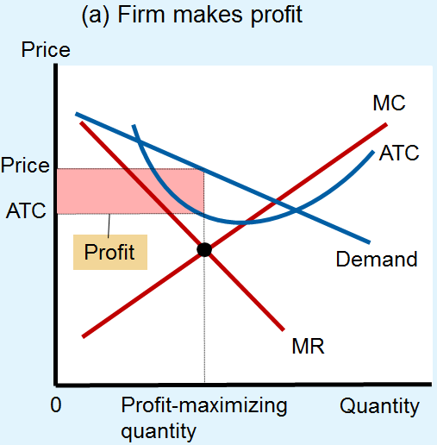
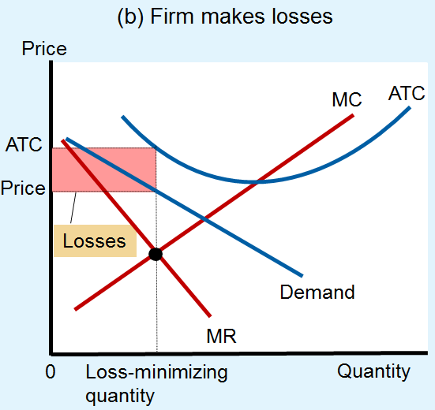
A Monopolistically Competitive Firm’s Profits in the Short Run

Slide 5
A Monopolistic Competitor in the Long Run
0
Entry and exit occurs until P = ATC and profit = zero.
Notice that the firm charges a markup of price over marginal cost and does not produce at minimum ATC.
Price
MC
ATC
P = ATC
markup
D
MC
MR
Q
Quantity
Notes:
5
The level of output that minimizes ATC is greater than the output that maximizes the monopolistic competitor’s profits. Hence, we say the monopolistic competitor operates with excess capacity. (More on this topic on the next slide.)

Slide 6
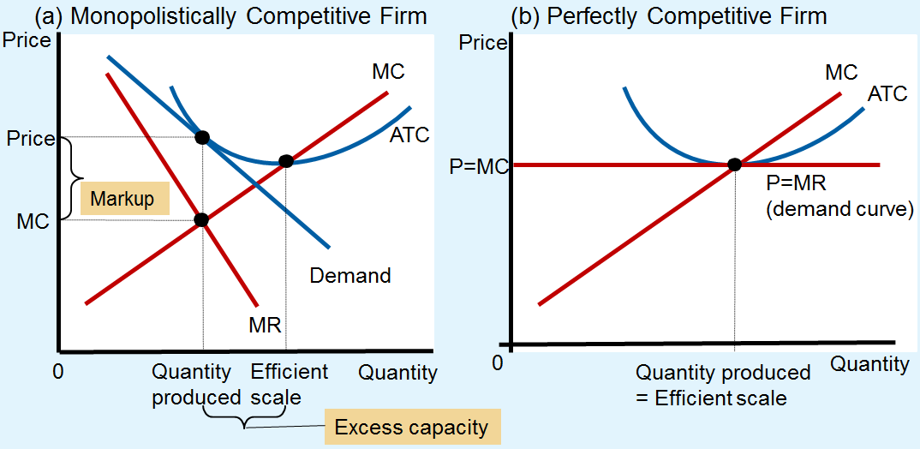

Slide 7
Why Monopolistic Competition Is Less Efficient than Perfect Competition
Monopolistic competition
Excess capacity: quantity is not at minimum ATC (it is on the downward-sloping portion of ATC)
Markup over marginal cost: P > MC
Perfect competition
Quantity: at minimum ATC (efficient scale)
P = MC
Notes:
Due to the markup of price over marginal cost, the market output under monopolistic competition will be smaller than the socially efficient output, as we discuss on the following slide.

Slide 8
Welfare of Society
Markup, P > MC
Market quantity < socially efficient quantity
Deadweight loss of monopoly pricing
The product-variety externality:
Consumers get extra surplus from the introduction of new products
The business-stealing externality:
Losses incurred by existing firms when new firms enter market
Notes:
The problem of markup pricing facing policymakers here is similar to the problem arising from natural monopoly:
With natural monopoly, ATC is always falling, so MC is below ATC. If regulators force a natural monopoly to price at marginal cost, it will incur losses. Yet, not easy for policymakers to fix this problem: Firms earn zero profits, so cannot require them to reduce prices.
The product-variety externality is a positive one for consumers; while the business-stealing externality is a negative one on existing producers. It’s not clear which externality effect is bigger, and it may in fact differ by industry.
The inefficiencies of monopolistic competition are subtle and hard to measure. No easy way for policymakers to improve the market outcome.

Slide 9
Advertising
In monopolistically competitive industries
Product differentiation and markup pricing lead naturally to the use of advertising
The more differentiated the products
The more advertising firms buy
Economists disagree about the social value of advertising:
Wasting resources?
Valuable purpose?

Slide 10
Advertising
Incentive to advertise
When firms sell differentiated products and charge prices above marginal cost
Advertise to attract more buyers
Advertising spending
Highly differentiated goods: 10-20% of revenue
Industrial products: Little advertising
Homogenous products: No advertising

Slide 11
Advertising
Advertising as a signal of quality
Little apparent information
Real information offered – a signal
Willingness to spend large
amount of money
= signal about quality of the product
Content of advertising = irrelevant
Notes:
A firm’s willingness to spend huge amounts on advertising may signal the quality of its product to consumers, regardless of the content of ads.
Ads may convince buyers to try a product once, but the product must be of high quality for people to become repeat buyers.
The most expensive ads are not worthwhile unless they lead to repeat buyers.
When consumers see expensive ads, they think the product must be good if the company is willing to spend so much on advertising.

Slide 12
Brand Names
In many markets, brand name products coexist with generic ones.
Brand names
Spend more on advertising and charge higher prices than generic substitutes
As with advertising, there is disagreement about the economics of brand names…

Slide 13
Advertising
Critics of brand names
Products – not differentiated
Irrationality: consumers are willing to pay more for brand names
Defenders of brand names
Consumers – information about quality
Firms – incentive to maintain high quality to protect the reputation of their brand name
Notes:
To conclude: Differentiated products are everywhere; and examples of monopolistic competition abound.
The theory of monopolistic competition describes many markets in the economy, yet offers little guidance to policymakers looking to improve the market’s allocation of resources.

